Slide 1
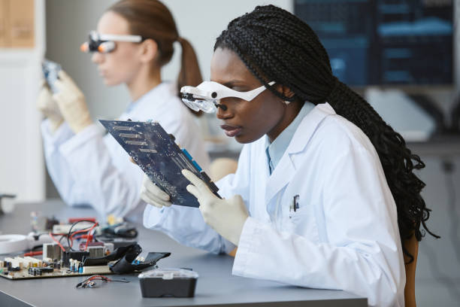

Empowering Young Girls in STEM for a Brighter Future
Life Source International School Ghana – Where Young Girls Shape the Future!

Slide 2

At Life Source International School, we believe in unlocking the boundless potential of young girls through STEM education. As an exclusive All-Girls STEM School, we provide a nurturing and intellectually stimulating environment for future leaders.

Slide 3
Our Vision
Life Source envisions a future where our scholars embody pragmatism and innovation, rising to meet the demands of tomorrow.
With a commitment to excellence in science education, we aim to expand across Africa, empowering future leaders and driving meaningful change in the world of science.

Slide 4
Our Mission
To foster leadership in girls' science education, empowering scholars to become leaders in their communities and drive meaningful change where it's needed most.

Slide 5
Unique Offerings - What Sets Us Apart?
Academic Excellence: Cambridge IGCSE, GCE Advanced Level, U.S. High School Diplomas, SAT and TOEFL exams
Global Experience: JI Student Visa Program for U.S. exchange
Affiliations & Partnerships: LSIS Ghana connects to Life Source California (Journey International School)
Leadership & Innovation: Leader in Me school, integrating Franklin Covey’s 7 Habits framework to instill leadership, teamwork, and adaptability.
Affordable Excellence: Competitive tuition & scholarship opportunities

Slide 6
Join the STEM Revolution!
💡 Gain the confidence to succeed
📢 Enrollment now open for the 2025-2026 academic year!
📍 Location: Apam Junction-Ankamu, Gomoa West District, Central Region, Ghana
🌍 Learn more: https://www.lifesourceghana.org
📩 Contact us: lifesourceelevateintacademy@gmail.com
LSIS, Confidence to Succeed

Slide 7
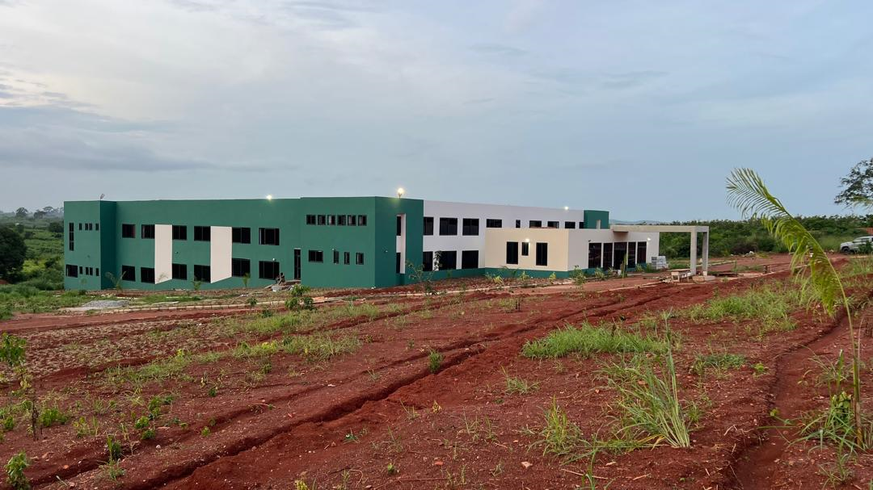

Slide 8
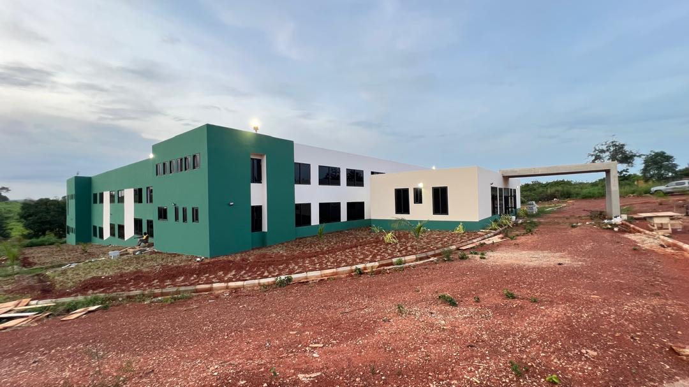

Slide 9
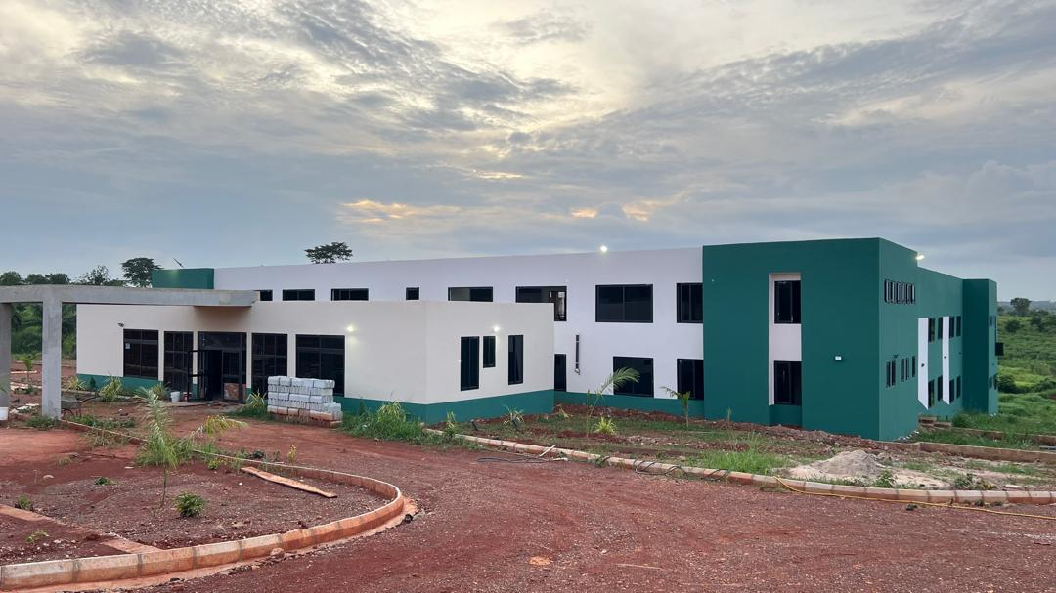

Slide 10
Welcome to LSIS Ghana!

